Slide 1
Lesson 5
Alphabet poetry + acrostic poetry +
Shape poetry / calliGRAM / CONCRETE VERSE

Slide 2
Alphabet poetry
Poems that use every letter of the alphabet
Can be as simple or as difficult as you want it to be:
Gashlycrumb Tinies - Edward Gorey
A Who’z Who of the Horrible House – Was Magee
Can you recognise any of the poetric elements in these poems?

Slide 3
A to Z – Michaela Morgan
A up said me dad,
B off to bed with you.
C it’s half past eight and I’ve
Decided that for now it’s bed before nine.
E can’t be serious I thought
F he carries on like this I’ll never see any TV
G I’ll lose my grasp of American slang.
H not fair.
I won’t go.
J think I should protest?
K I will.
L o said me dad,
M not standing for this
N y kid thinks he can disobey me has got another thing coming.
O yes he has!
P, then wash your hands and face, do your teeth and straight to bed.
Q then, your sisters will have finished soon.
R you ready yet? Wash that face properly
S pecially round your nose. It’s disgusting.
T? No you can’t. If you drink tea now you will wet the bed
U will you know.
V end of a perfect day. Now I’ll tuck you in
W up to save space. Then I can fit your brother in too- and the dog and the hamster. There you all fit in.
Xactly.
Y don’t you like it? It’s cosy, space-saving, economical. Go to sleep. Not a peep. Do exactly as I
ZZZZZZZZZZZZZZZZZZZZZZZZZZ

Slide 4
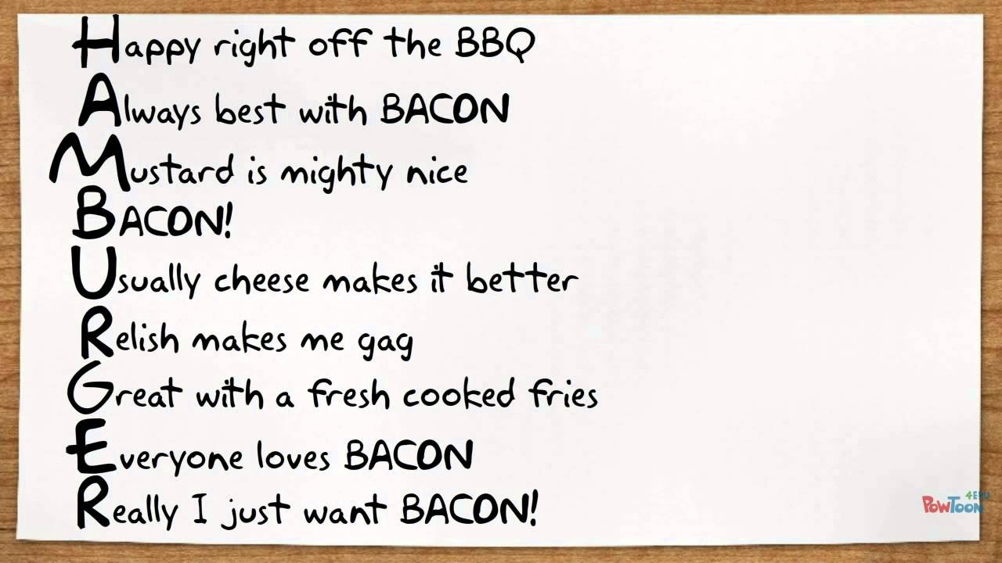
Acrostic poetry
The first word of each line makes a word or phrase downwards.

Slide 5
exercise
Try to write an acrostic poem

Slide 6
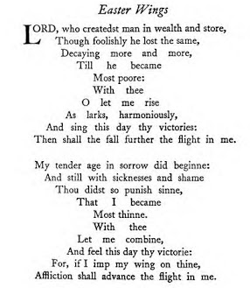
Easter wings
George Herbert
What does the shape represent?
How does the shape affect the poem?
Notes:
Wings, Angels, God
Above = good
Down = bad

Slide 7
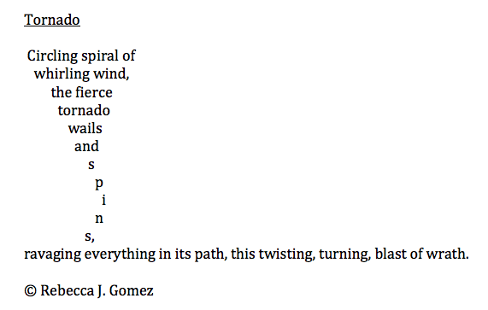
Shape poem
The shape of the poem symbolises the subject of the poem.

Slide 8
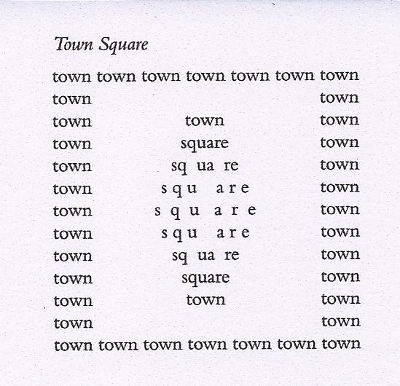
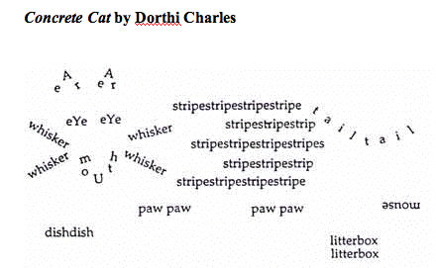
Concrete verse
Not necessarily a poem. Words that describe the subject become an image of the subject.

Slide 9
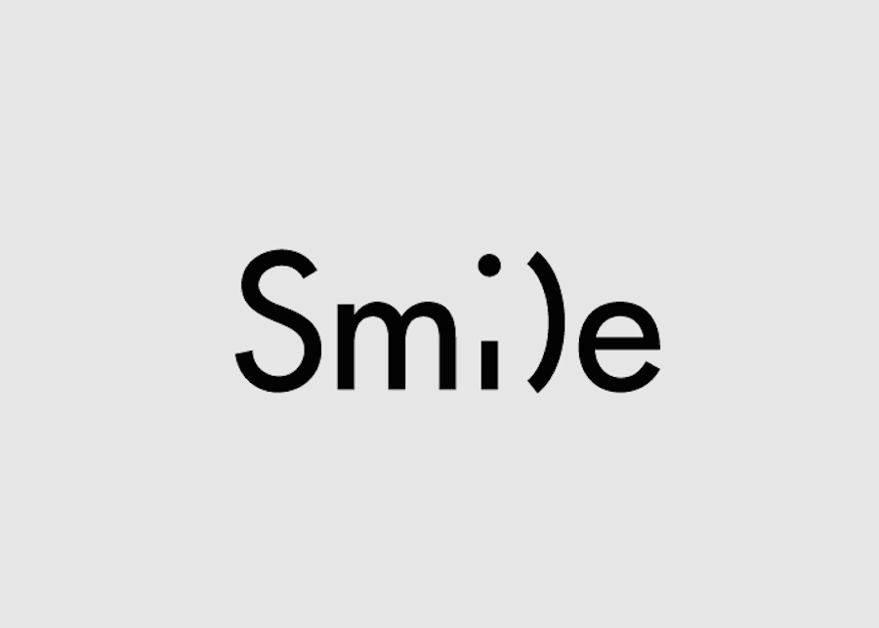
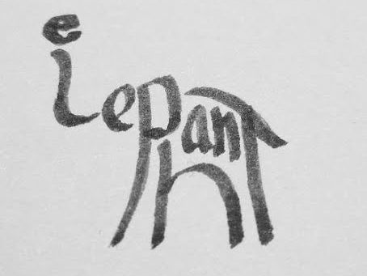
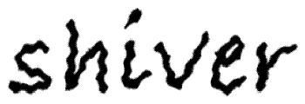
Calligram
Shape of the letters, words or whole poem to show the subject of the calligram in a visual way.

Slide 10
Exercise
Discuss: is this still poetry?
Try to make your own shape poem/calligram/concrete verse

